Slide 1








WEEK 2 EVALUATION PRESENTATION
React Deep Dive, MongoDB & Next.js Architecture
Wasiur Rahman Sakib Software Engineer Intern | Web & Mobile Full-Stack Engineering

Slide 2









EXECUTIVE OVERVIEW
React Paradigm
State & Hooks
Declarative UI state management
Immutability Principles enforced
Virtual DOM Diffing & Reconciliation
useEffect Lifecycle synchronization
Unidirectional Data Flow mechanism
Custom Hooks logic abstraction
Database Layer
Full-Stack Bridge
MongoDB BSON Documents structure
Next.js App Router utilization
Mongoose Schemas & strict validation
Server vs Client Components delineation
Advanced Data Aggregation pipelines
Unified API route architecture

Slide 3


REACT CORE & IMMUTABILITY
Uni-directional Flow
Props flow down, Events bubble up. Establishes a predictable, single source of truth for component state.
Virtual DOM Engine
Maintains an in-memory tree representation. Utilizes heuristic reconciliation diffing for highly batched repaints.
State Immutability
Relies on reference equality (prev !== next). Safely updating states via spread [...prev] and .map().

Slide 4






LIFECYCLE & CUSTOM HOOKS
useEffect Sync
Cleanup Mechanism
Custom Hooks
Synchronizes component with external systems.
Aborts pending HTTP network requests.
Abstracts reusable UI business logic.
useFetch for Async state handling.
Strictly controlled via dependency arrays.
Clears active JavaScript timers/intervals.
useToggle for Boolean modal switches.
Prevents infinite re-rendering loops.
Crucial for preventing silent memory leaks.

Slide 5






DATABASE & FRAMEWORK
MongoDB (BSON)
Mongoose ODM
Next.js Paradigm
Flexible, schema-less document model.
Enforces strict schema validation logic.
Server Components with Zero JS bundle.
Optimized embedded sub-documents.
Automated field type casting/coercion.
Explicit Client interactivity ('use client').
Powerful Aggregations ($match, $group).
Pre/Post database middleware hooks.
Integrated API routes for backend logic.

Slide 6



TECHNICAL CHALLENGES & SOLUTIONS
CHALLENGE 01
SOLUTION
Async race condition crashing unmounted components.
Implemented AbortController & useEffect explicit cleanup.
CHALLENGE 02
SOLUTION
State array in-place mutation skipping UI repaints.
Enforced pure transformations via spread syntax [...prev].
CHALLENGE 03
SOLUTION
Database connection multi-spawning on hot reloads.
Architected a global singleton cached connection promise.

Slide 7








ENGINEERING TAKEAWAYS & BEST PRACTICES
Declarative UI Flow
Single Source of Truth
Prioritizing state-driven rendering logic over error-prone, imperative DOM manipulation. Let the state dictate the view.
Lifting state up the component tree to eliminate data desynchronization bugs between sibling components.
Defensive UI Patterns
Modular Architecture
Implementing explicit loading skeletons, comprehensive error boundaries, and safe fallbacks for better UX.
Enforcing a clean, rigid separation of UI presentation components and underlying custom hook business logic.

Slide 8
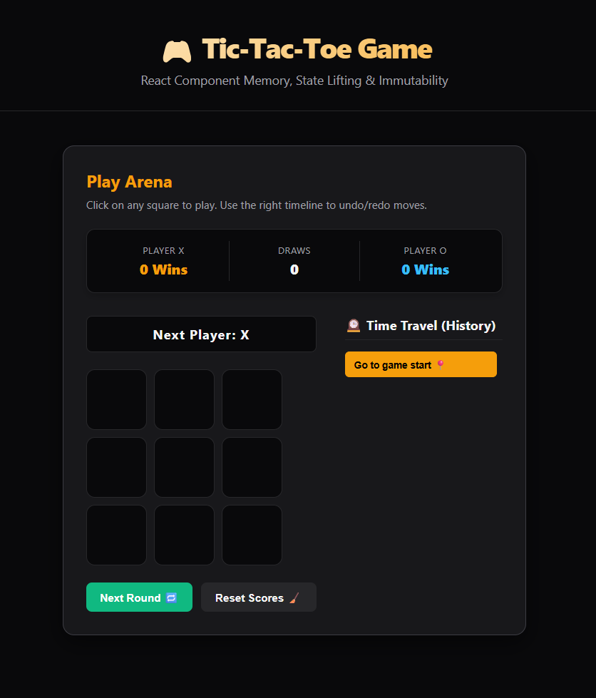

PRACTICAL PROJECT DEMO
Tic-Tac-Toe Arena
Features an immutable board history, time-travel move jumping capabilities, and purely calculated win logic isolated from UI rendering.
Custom Hooks Suite
Demonstrates useFetch for seamless loading/error lifecycle management and useToggle for isolated boolean modal triggers.

Slide 9
ROADMAP & FUTURE MILESTONES
Week 3: Academic Leave
University Midterm Examinations. Concurrent background focus on React & Full-Stack concept consolidation and deep review.
Week 4: Mobile Dev Start
Diving into React Native for cross-platform iOS/Android apps. Exploring core elements (FlatList, View), React Navigation, Device APIs, and Backend integration.

Slide 10

THANK YOU!
Questions & Live Project Walkthrough
Launch Live Application
Presented by Wasiur Rahman Sakib Software Engineer Intern

